Slide 1
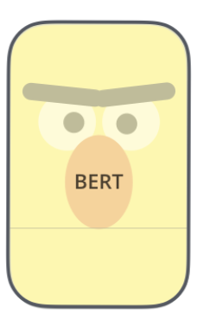
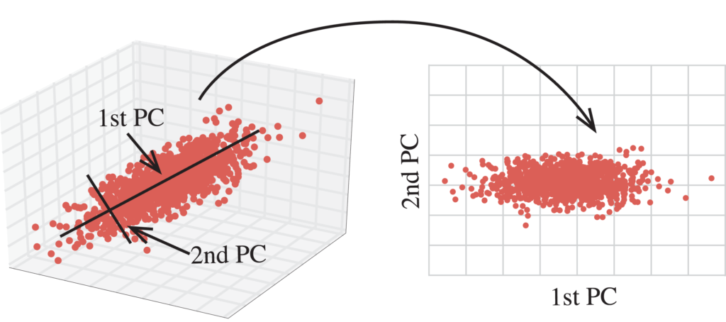
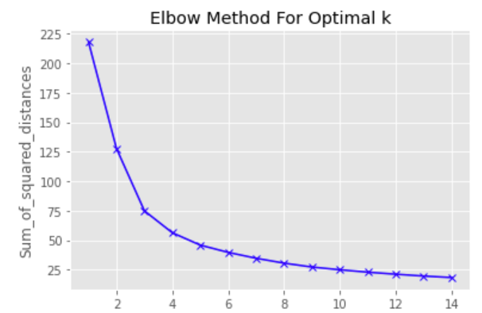
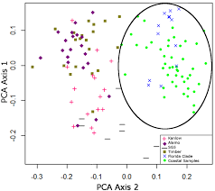
Texts
Embedding
Sentence-BERT
Dimensionality Reduction
PCA
Look for optimal K
Kmeans
Clustering
Elbow Method

Slide 2
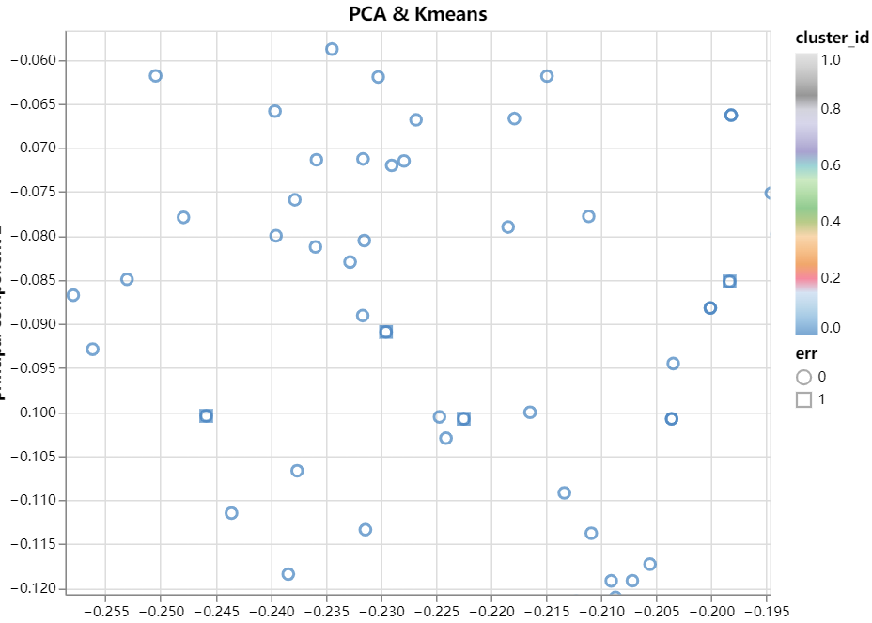


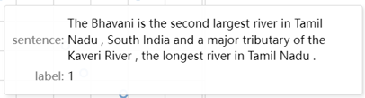

Slide 3
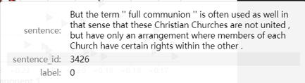
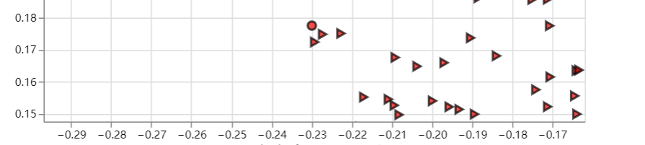
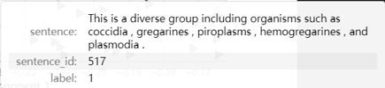
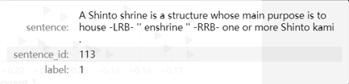

Slide 4
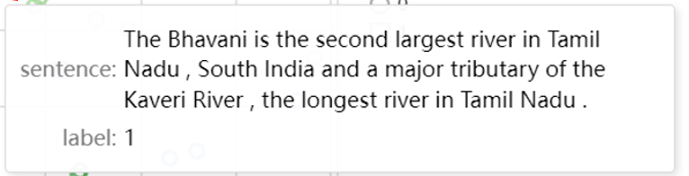
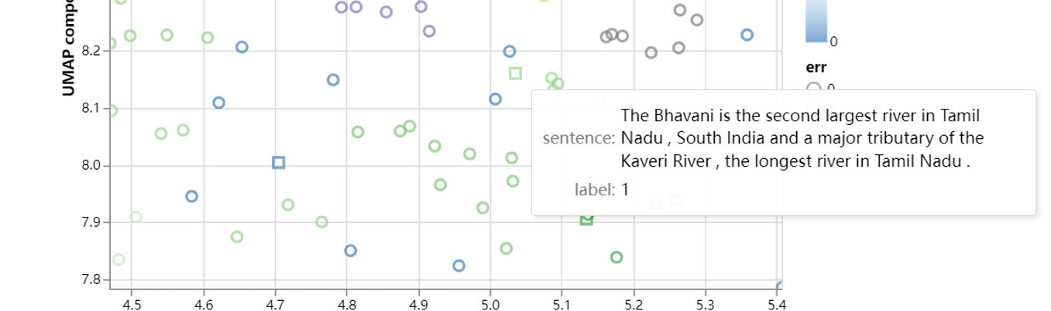

Slide 5
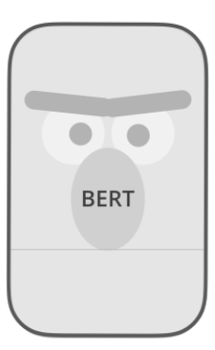
Situation 1: Correct classification on Pretrain BERT
Pretrain BERT
0
Test Text a
0
Train, then evaluation
Remove one record, train, then evaluation
0
0
0
0
Test Text a
Test Text a
Train Text b
Train Text b
Similar sentence
Similar sentence
Pretrain BERT
Trained BERT
Pretrain BERT
Trained BERT
1
1
Train Text c
Train Text c
Similar sentence
Similar sentence
1
1
Train Text d
Train Text d
0
Label 1 label 0
1
Similar sentence
Label 1 label 0
Similar sentence
2 > 1
1 = 1

Slide 6

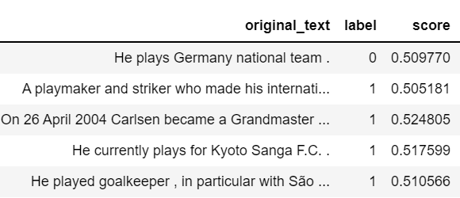
Situation 1: Correct classification on Pretrain BERT
Test Sentence
Prediction by Pretrain model
Ground Truth
Prediction by Fine tuning without preprocessing
Similarity score in cosine.
Ground Truth
Training Sentences
Label 1 label 0
4 > 1
Similar sentences

Slide 8
Situation 2: Wrong classification on Pretrain BERT
Pretrain BERT
0
Test Text e
1
Train, then evaluation
Remove one record, train, then evaluation
0
0
0
0
Test Text e
Test Text e
Train Text f
Train Text f
Similar sentence
Similar sentence
Change
Pretrain BERT
Pretrain BERT
Trained BERT
Trained BERT
1
0
Train Text g
Train Text g
Similar sentence
Similar sentence
Label 1 label 0
1
1
1 = 1
Label 1 label 0
1 < 2

Slide 9

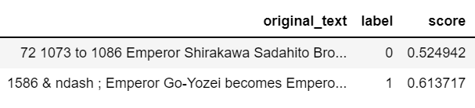
Situation 2: Wrong classification on Pretrain BERT
Test Sentence
Both prediction are wrong.
Training Sentences
Label 1 label 0
1 = 1

